Slide 1
LESSON 8
BOOK CHAPTER 25
CAPACITANCE

Slide 2
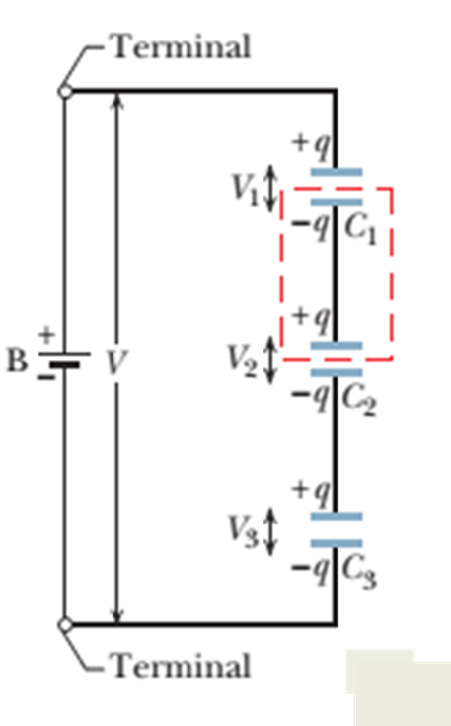

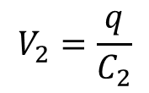
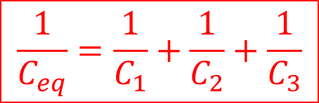
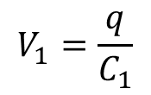
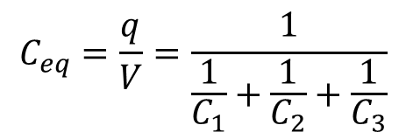
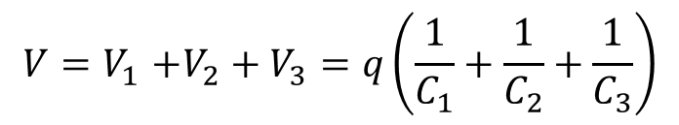
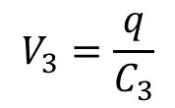
Capacitors in series combination:
Potential difference of each actual capacitor:
$$V_{1}=\frac{q}{C_{1}}$$
$$V_{2}=\frac{q}{C_{2}}$$
And
$$V_{3}=\frac{q}{C_{3}}$$
The total potential difference V due to the battery is the sum of these three potential differences. Thus,
$$V{=V}_{1}+V_{2}+V_{3}=q\left(\frac{1}{C_{1}}+\frac{1}{C_{2}}+\frac{1}{C_{3}}\right)$$
The equivalent capacitance is then
$$C_{eq}=\frac{q}{V}=\frac{1}{\frac{1}{C_{1}}+\frac{1}{C_{2}}+\frac{1}{C_{3}}}$$
$$\frac{1}{C_{eq}}=\frac{1}{C_{1}}+\frac{1}{C_{2}}+\frac{1}{C_{3}}$$

Slide 3
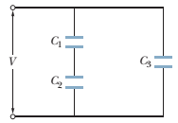


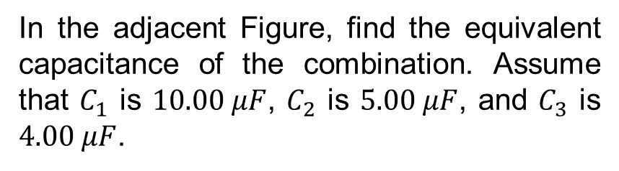




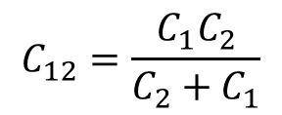

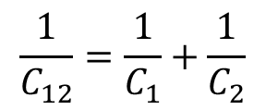

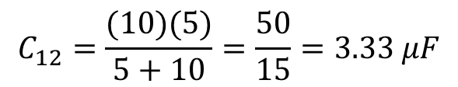


Problem 10 (Book chapter 25):
In the adjacent Figure, find the equivalent capacitance of the combination. Assume that $C_{1}$ is $10.00 μF$, $C_{2}$ is $5.00 μF$, and $C_{3}$ is $4.00 μF$.
Answer:
Step1: $C_{1} and C_{2} are in series$
Given
$$\frac{1}{C_{12}}=\frac{1}{C_{1}}+\frac{1}{C_{2}}$$
$$C_{12}=\frac{C_{1}C_{2}}{C_{2}+C_{1}}$$
$$C_{1}=10 μF$$
$$C_{2}=5 μF$$
or
$$C_{3}=4 μF$$
$$C_{12}=\frac{(10)(5)}{5+10}=\frac{50}{15}=3.33 μF$$
$$C_{3}$$
$$C_{12}$$
Step2: $C_{12} and C_{3} are in parellel$
$$C_{123}=C_{12}+C_{3}=3.33+4=7.33 μF$$
$$C_{123}$$

Slide 4
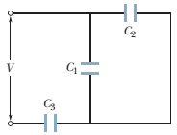
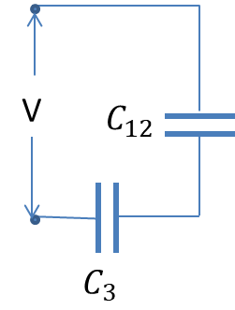




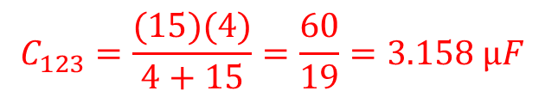


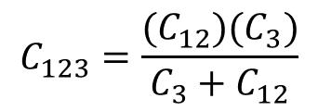

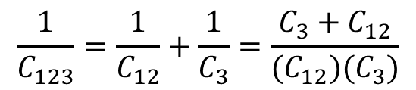
Problem 11 (Book chapter 25):
In the adjacent Figure, find the equivalent capacitance of the combination. Assume that $C_{1}$ is $10.00 μF$, $C_{2}$ is $5.00 μF$, and $C_{3}$ is $4.00 μF$.
Answer:
Step1: $C_{1} and C_{2} are in parellel$
Given
$$C_{1}=10 μF$$
$$C_{12}{=C}_{1}+C_{2}=10+5=15 μF$$
$$C_{2}=5 μF$$
Step2: $C_{12} and C_{3} are in series$
$$C_{3}=4 μF$$
$$\frac{1}{C_{123}}=\frac{1}{C_{12}}+\frac{1}{C_{3}}=\frac{C_{3}+C_{12}}{(C_{12})(C_{3})}$$
$C_{123}=$?
$$C_{123}=\frac{{(C}_{12})(C_{3})}{C_{3}+C_{12}}$$
$$C_{123}$$
$$C_{123}=\frac{(15)(4)}{4+15}=\frac{60}{19}=3.158 μF$$

Slide 5


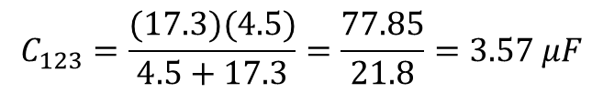

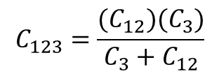
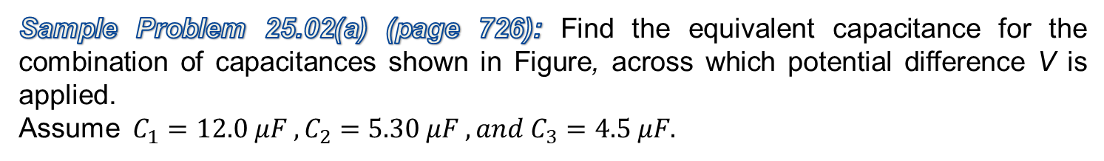
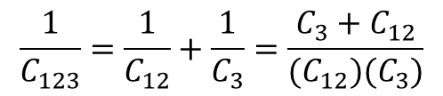
Sample Problem 25.02(a) (page 726): Find the equivalent capacitance for the combination of capacitances shown in Figure, across which potential difference V is applied.
Assume $C_{1}=12.0 μF , C_{2}=5.30 μF , and C_{3}=4.5 μF.$
Home Task
Step1: $C_{1} and C_{2} are in parallel$
$$C_{123}=\frac{{(C}_{12})(C_{3})}{C_{3}+C_{12}}$$
$$C_{12}{=C}_{1}+C_{2}=12+5.3=17.3 μF$$
Step2: $C_{12} and C_{3} are in$series
$$C_{123}=\frac{(17.3)(4.5)}{4.5+17.3}=\frac{77.85}{21.8}=3.57 μF$$
$$\frac{1}{C_{123}}=\frac{1}{C_{12}}+\frac{1}{C_{3}}=\frac{C_{3}+C_{12}}{(C_{12})(C_{3})}$$

Slide 6
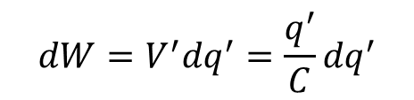
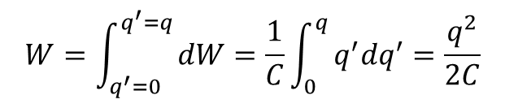
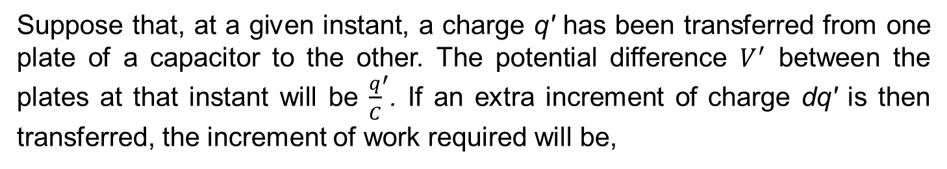
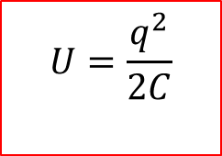
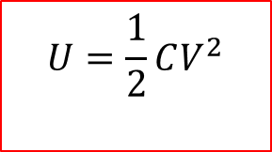
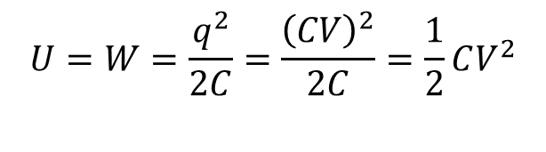
Energy Stored in an Electric Field:
Suppose that, at a given instant, a charge q' has been transferred from one plate of a capacitor to the other. The potential difference $V^{′}$ between the plates at that instant will be ${\frac{q}{C}}^{′}$. If an extra increment of charge dq' is then transferred, the increment of work required will be,
$$dW=V^{′}{dq}^{′}=\frac{q^{′}}{C}{dq}^{′}$$
The work required to bring the total capacitor charge up to a final value q is
$$W=\int_{q^{′}=0}^{q^{′}=q}{dW=\frac{1}{C}\int_{0}^{q}{q^{′}{dq}^{′}=\frac{q^{2}}{2C}}}$$
This work is stored as potential energy U in the capacitor, so
$$U=W=\frac{q^{2}}{2C}=\frac{{\left(CV\right)}^{2}}{2C}=\frac{1}{2}CV^{2}$$
$$U=\frac{q^{2}}{2C}$$
Finally,
$$U=\frac{1}{2}CV^{2}$$
OR

Slide 7
Thank You

